Slide 1
Introduction to R
shirleywang.rbind.io
shirleywang@g.harvard.edu
@shirleybwang
Day 1: Data Cleaning & Wrangling
Shirley Wang
March 18, 2021

Slide 2
Day 1 Goals
Download & install R & RStudio
Become familiar with the RStudio environment
Operations
Objects (what they are & how to create them)
Data types
Functions

Slide 3
Day 1 Goals
Download & install R & RStudio
Become familiar with the RStudio environment
Operations
Objects (what they are & how to create them)
Data types
Functions

Slide 4
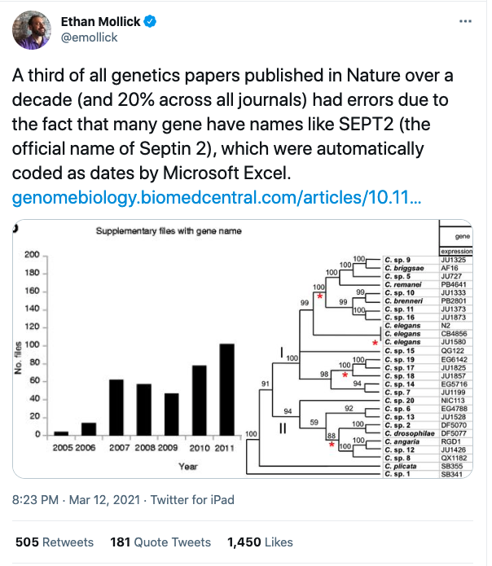
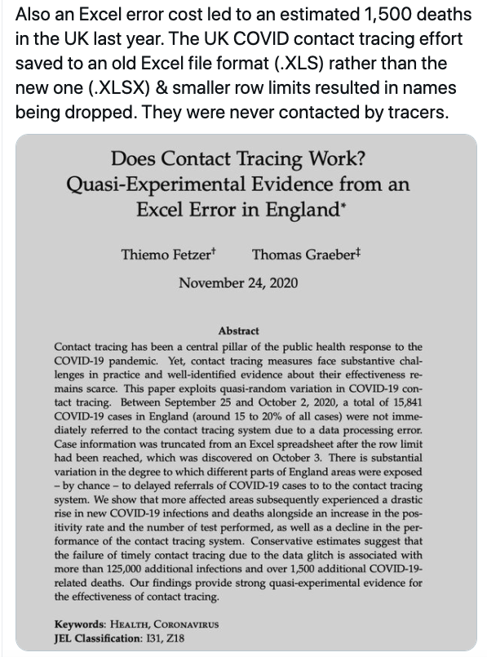
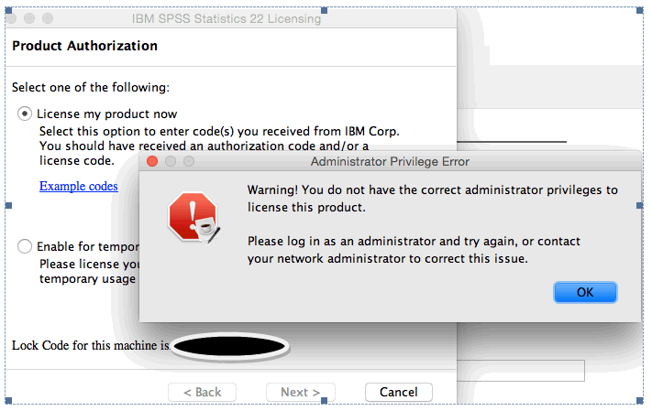
Why use R?

Slide 5
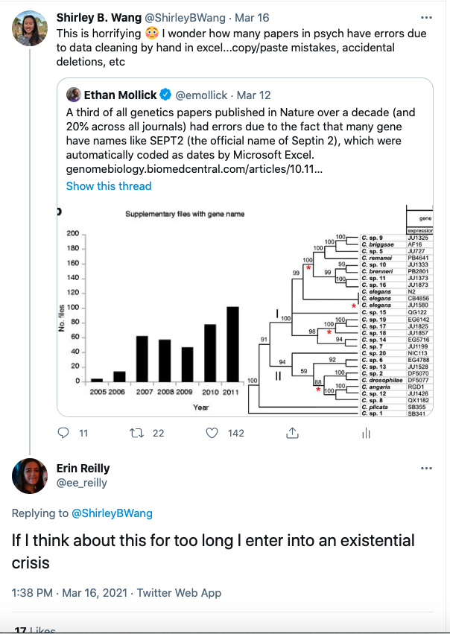
Why use R?

Slide 6
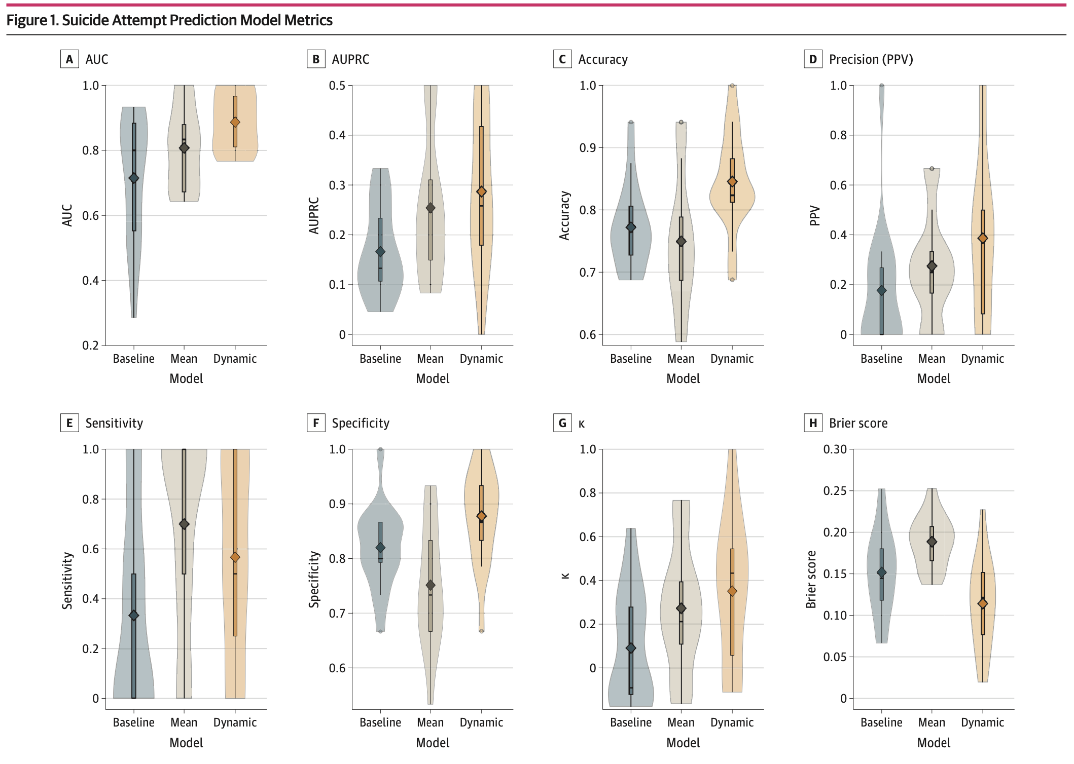

Slide 7
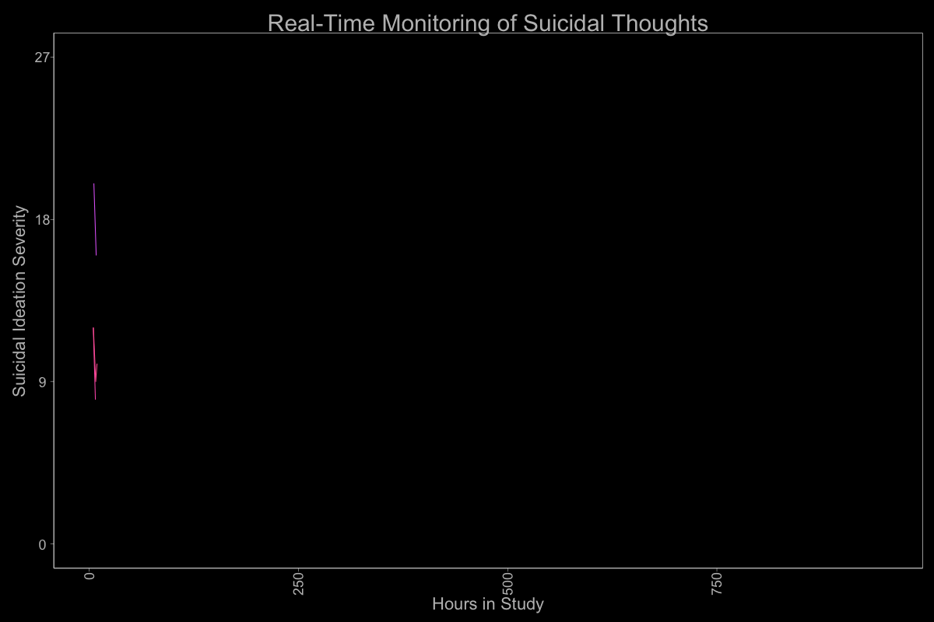

Slide 8
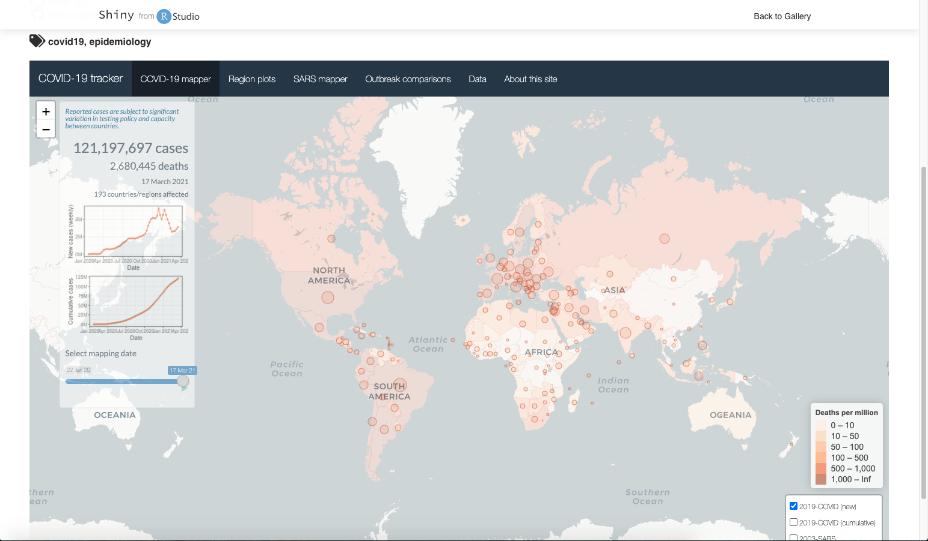

Slide 9
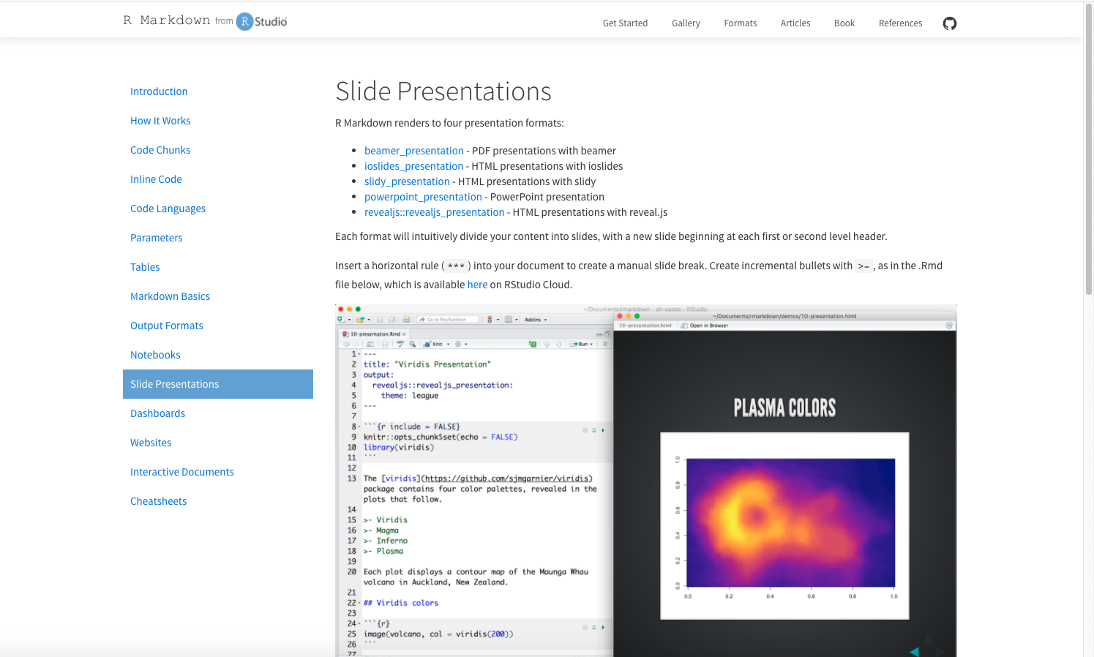

Slide 10
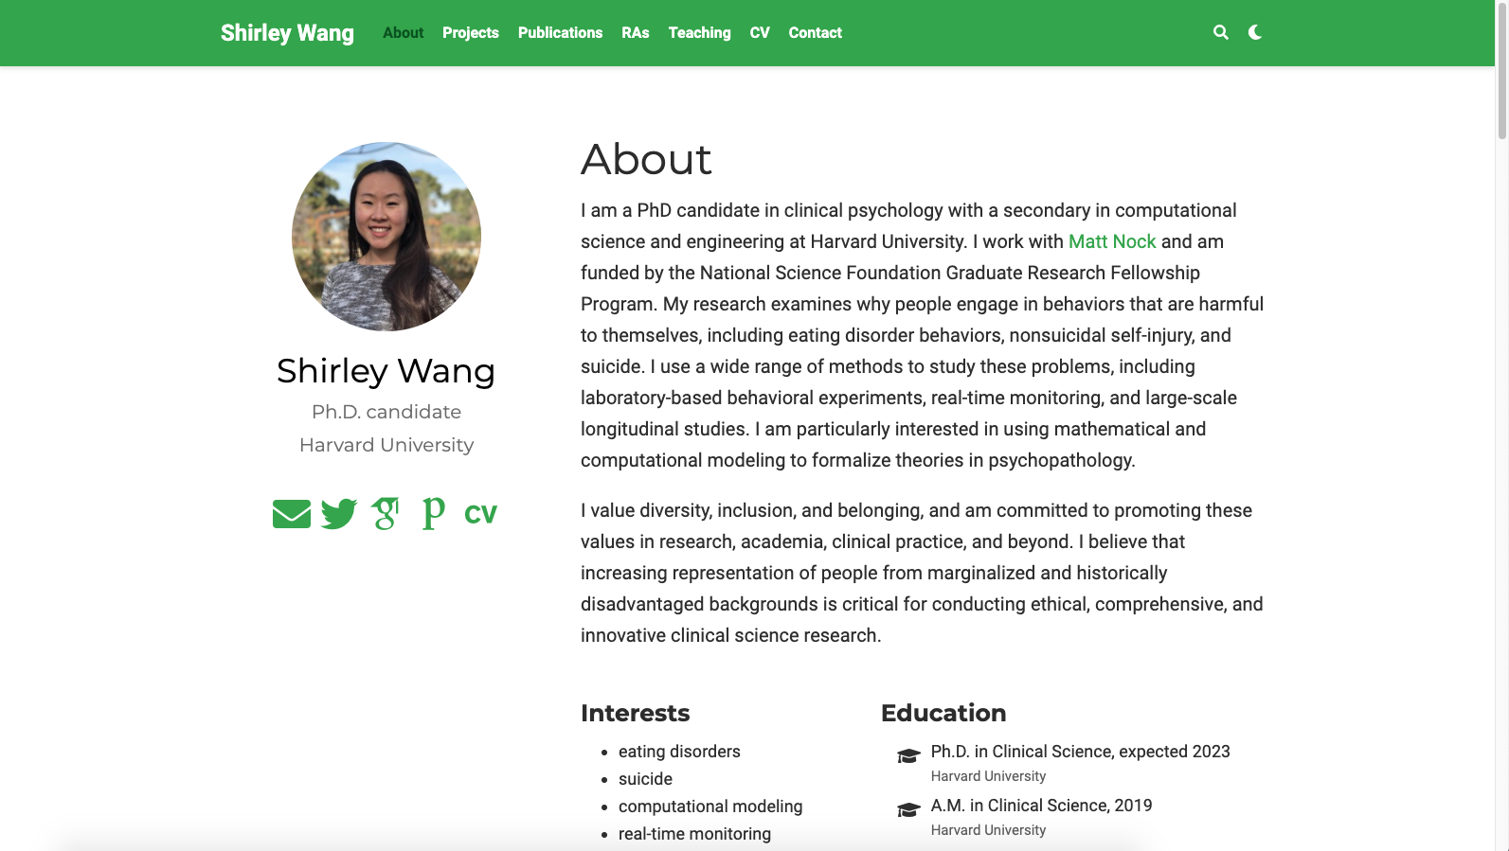

Slide 11
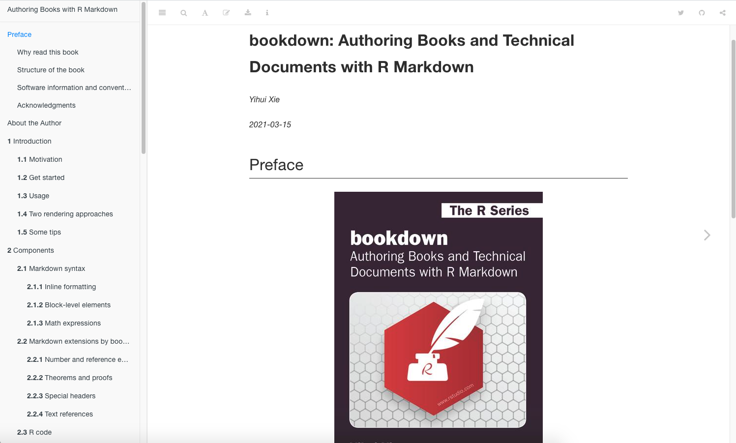

Slide 12
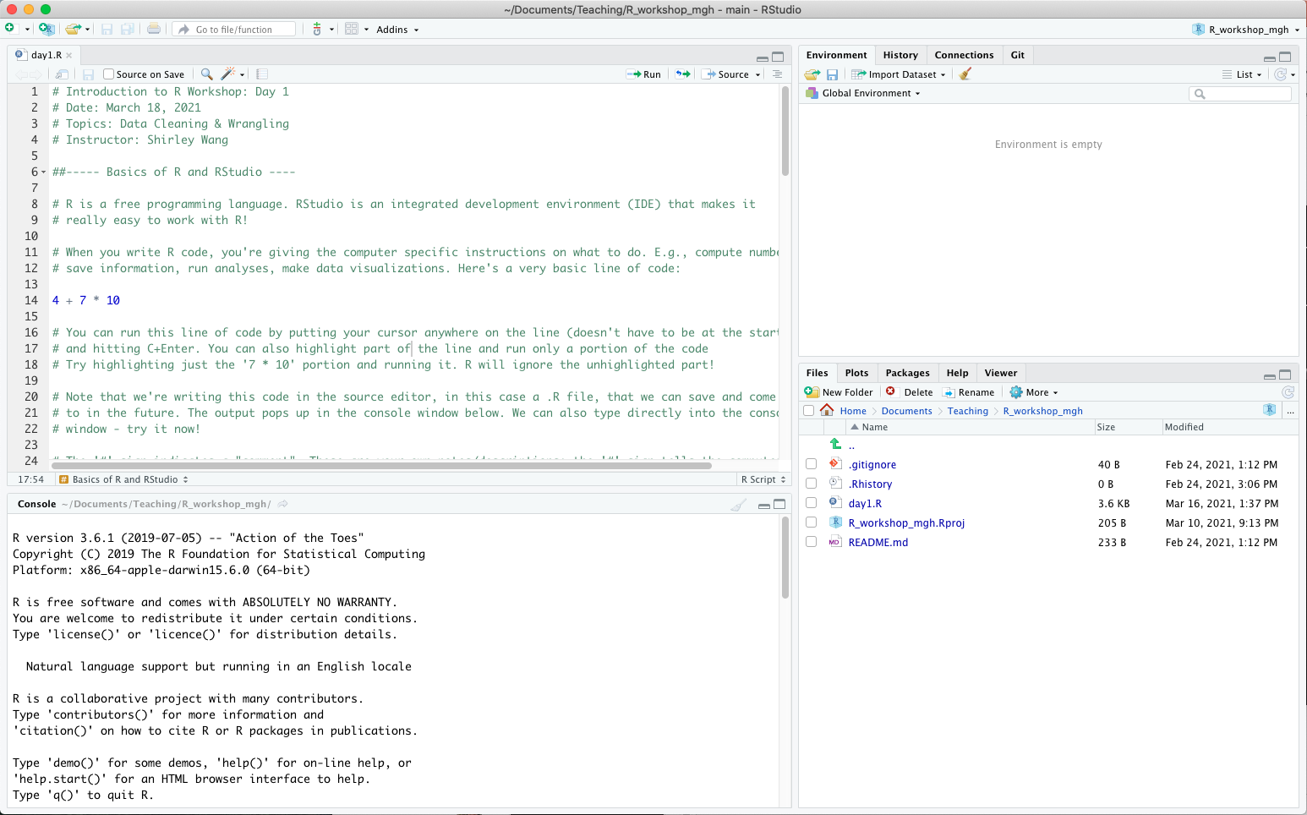
R & RStudio Orientation
R is a free programming language
RStudio is an IDE that makes it easier write, run, and save R code!
workspace/history
code/source editor
files/packages/plots
console

Slide 13
R Basics
Case sensitive
Run lines of code with cmd+Enter
Get help with ? or help()
Comment your code with #

Slide 14
R Basics
Case sensitive
Run lines of code with cmd+Enter
Get help with ? or help()
Comment your code with #

Slide 15
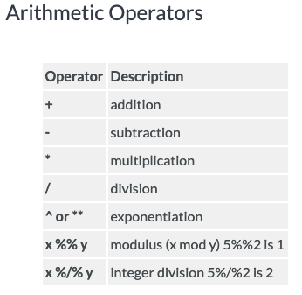
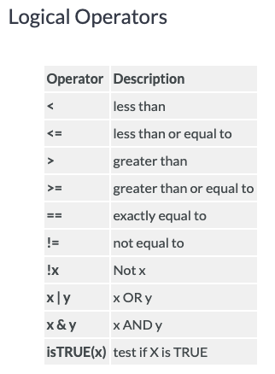
Operations in R
https://www.statmethods.net/management/operators.html
Notes:
In many ways R is just like a calculator

Slide 16
Objects in R
Objects store information (can be an entire dataset, a single value, a string of text, an image, etc)
Assign values using ‘<-’
Value on the right-hand side gets assigned to object name on the left-hand side (e.g., myname <- ‘shirley’; myage <- 26)
Rules for object names:
Must start with a letter
Can only contain letters, numbers, periods, underscores
Case-sensitive

Slide 17
Data Types
Numeric
Integer
Character
Factor
Logical
Check data types in R with class()

Slide 18
Data Structures
Vector
Matrix
Array
Data frame
List

Slide 19
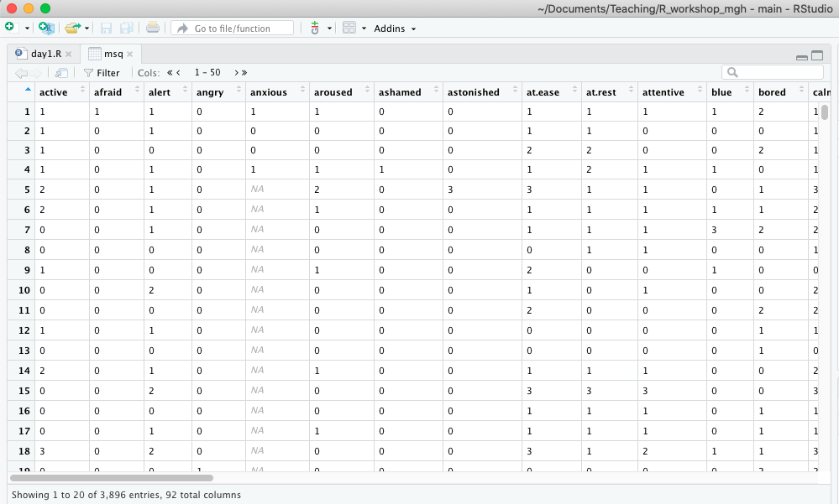
Data Structures
Vector
Matrix
Array
Data frame
List

Slide 20
Data Frames
Access columns with ‘$’ (e.g., df$age accesses the column named ‘age’ in the data frame ‘df’)
View(df) to view data frame in excel-like format
dim(df) to get dimensions (# rows, # columns)
nrow(df)
ncol(df)
str(df) to view structure of data frame
colnames(df) to view all column (variable) names

Slide 21
Functions
Sets of instructions/statements to complete a specific task; takes input (e.g., numbers) and returns an output (e.g., mean of those numbers)
R comes with many built-in functions (e.g., mean(), min(), max(), print())
You can also write your own functions to perform specific tasks!
function(arguments)
myFunction <- function(input) {# do something; return output}

Slide 22
Packages
R packages are bundles of functions, documentation, and data to perform tasks (e.g., machine learning, natural language processing, data visualization)
Anyone can build an R package to share with other R users!
Hosted on the central R repository CRAN: https://cran.r-project.org/
Currently over 17,000 packages available
Packages need to be installed on your computer, and loaded at the start of each new R session
install.packages(‘ggplot2’)
library(ggplot2)

Slide 23
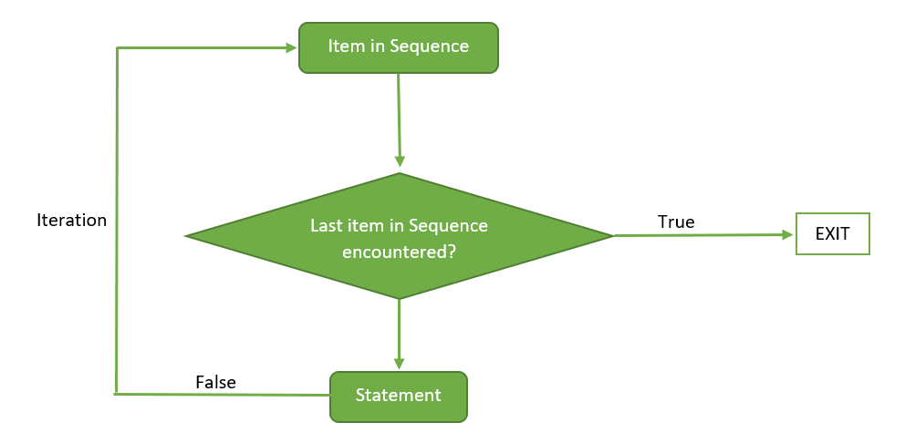
Loops
Loops are useful to repeat a block of code multiple times
Rather than copy/pasting code several times, you can iterate through a loop! This can shorten hundreds of lines of code to just a few lines.

Slide 24
Thank you!
shirleywang.rbind.io
shirleywang@g.harvard.edu
@shirleybwang
Helpful resources:
https://psyr.djnavarro.net/
https://swirlstats.com/
https://r4ds.had.co.nz/
https://www.r-bloggers.com/
https://stackoverflow.com/

